Slide 1
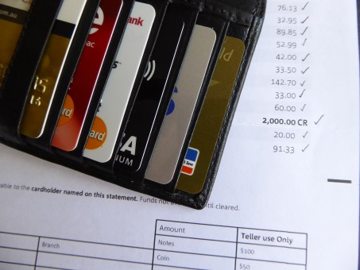
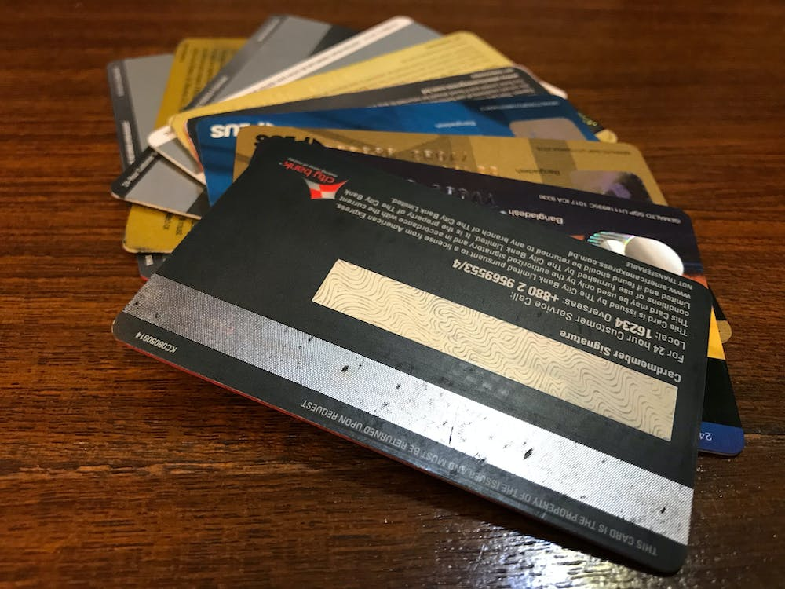
Credit Card Fraud Detection
By Surya Prakash Singh

Slide 2

Credit Card Fraud Detection
Project Overview
Finex is a leading financial service provider based out of Florida, US. It offers a wide range of products and business services to customers through different channels, ranging from in-person banking and ATMs to online banking. Over the last few years, Finex has observed that a significantly large number of unauthorized transactions are being made, due to which the bank has been facing a huge revenue and profitability crisis. Many customers have been complaining about unauthorized transactions being made through their credit/debit cards. It has been reported that fraudsters use stolen/lost cards and hack private systems to access the personal and sensitive data of many cardholders. They also indulge in ATM skimming at various POS terminals such as gas stations, shopping malls, and ATMs that do not send alerts or do not have OTP systems through banks. Such fraudulent activities have been reported to happen during non-peak and odd hours of the day leaving no room for suspicion.
In most cases, customers get to know of such unauthorised transactions happening through their cards quite late as they are unaware of such ongoing credit card frauds or they do not monitor their bank account activities closely. This has led to late complaint registration with Finex and by the time the case is flagged fraudulent, the bank incurs heavy losses and ends up paying the lost amount to the cardholders.
Now, Finex is also not really equipped with the latest financial technologies, and it is becoming difficult for the bank to track these data breaches on time to prevent further losses. The Branch Manager is worried about the ongoing situation and wants to identify the possible root causes and action areas to come up with a long-term solution that would help the bank generate high revenue with minimal losses.

Slide 3
Credit Card Fraud Detection
Data Collection and Preprocessing
Step 1
Reading
Understanding
Step 2
Data Cleaning (removing unwanted data)
Handling missing Values.
Step 3: EDA
Get dummies for categorical data
Binary conversion for Yes & NO
Step 4: Train- Test Split
We distributed our data 70:30(Train: Test)
Step 5: Scaling of features
drop highly correlated dummy variables.
Step 6: Building a model using Stats Model and RFE
Conclusion
Step 4: Data Preparation
Bivariate and Univariate
Multivariate

Slide 4
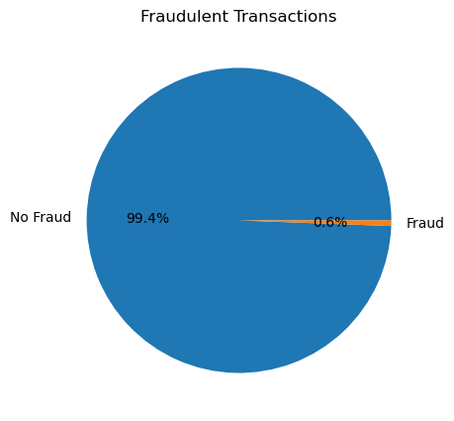
Credit Card Fraud Detection
99.4% is not fraud and only 0.6% is fraud leads to imbalanced data.

Slide 5
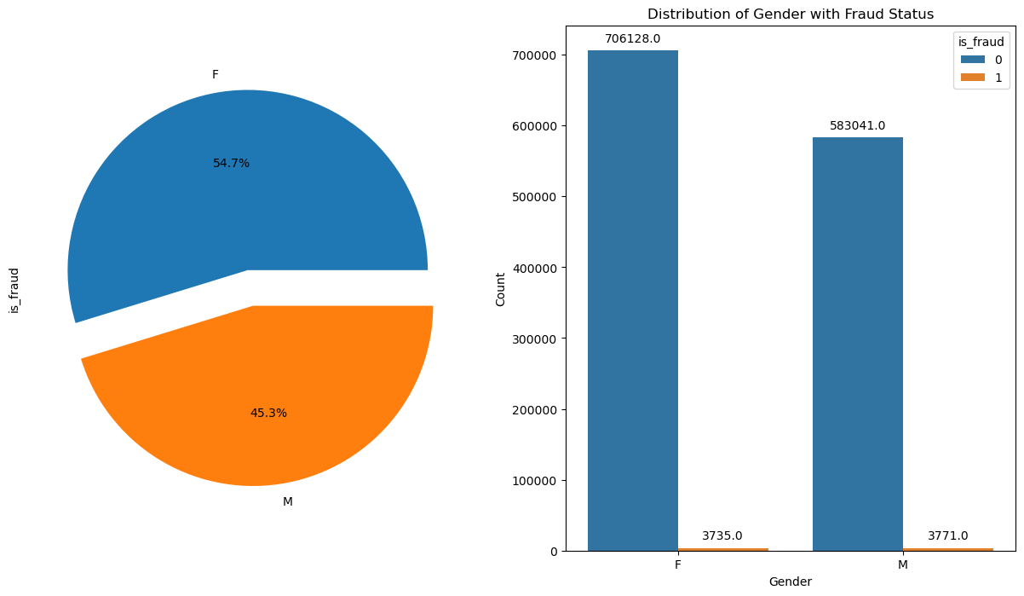
Credit Card Fraud Detection
Females are doing more transactions but Males are more likely to make fraud transaction

Slide 6
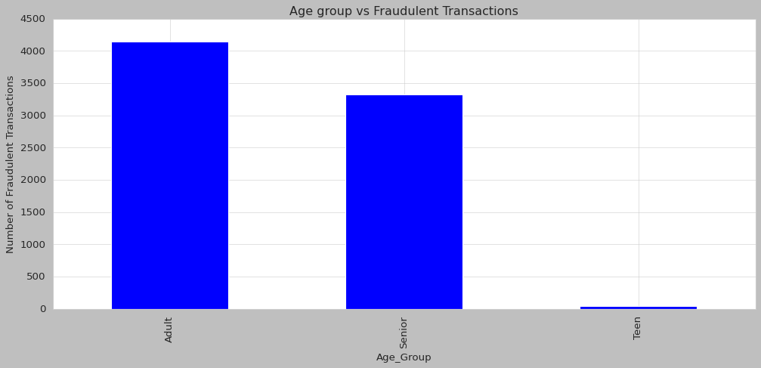

Credit Card Fraud Detection
Adult are more likely to make fraud transaction

Slide 7
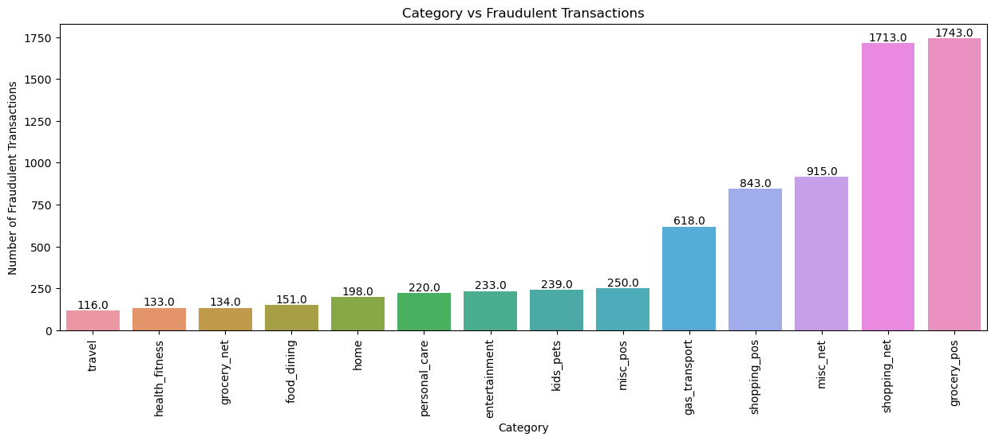
Credit Card Fraud Detection
We saw that most of the fraud transaction happened for grocery_pos and shopping_net

Slide 8
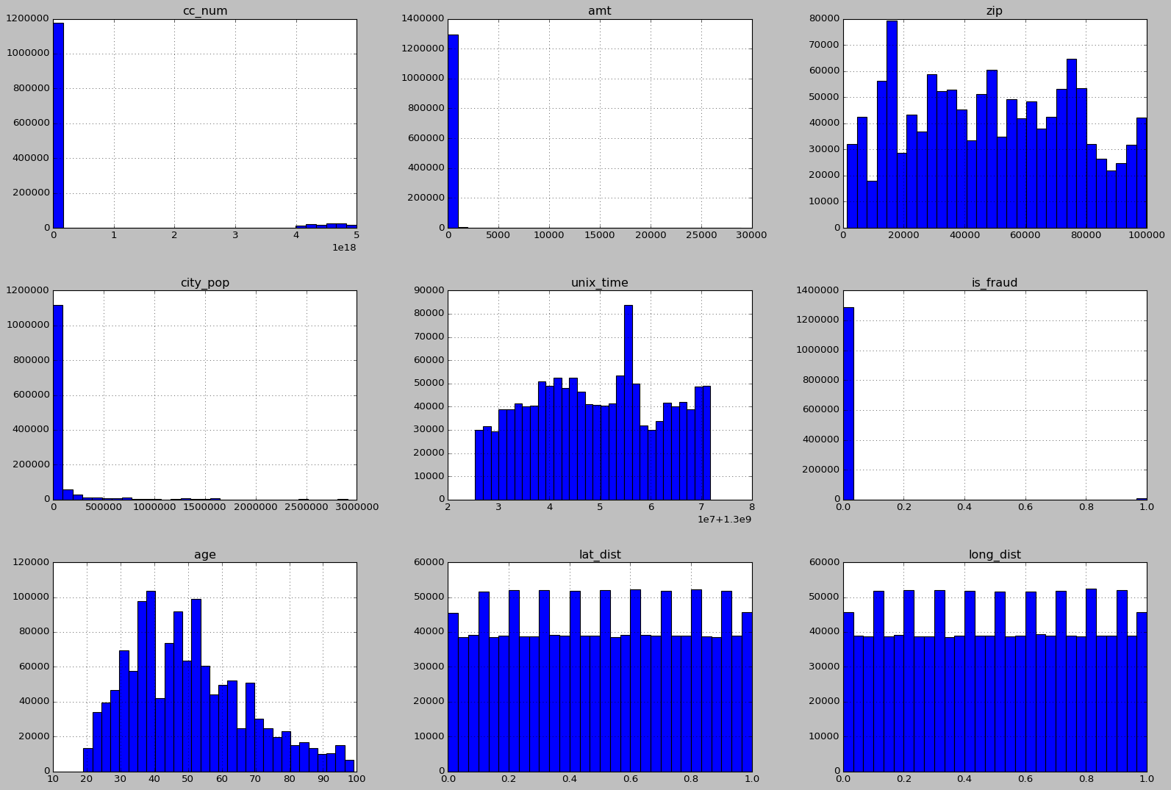
Credit Card Fraud Detection
Plotted histogram for numerical columns to understand the distribution of data

Slide 9
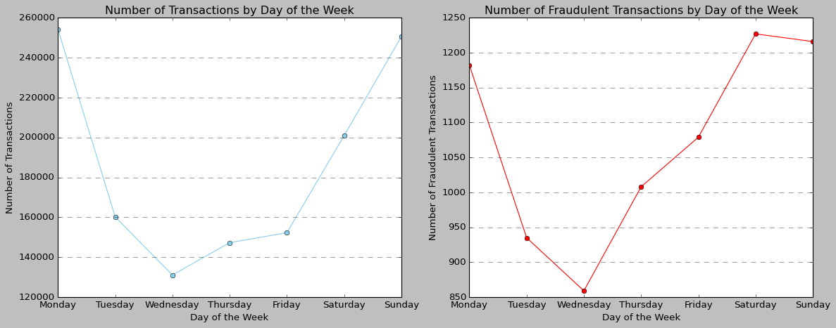
Credit Card Fraud Detection
We saw that most of the Fraud transactions occur most frequently on Mondays, Saturdays and Sundays

Slide 10
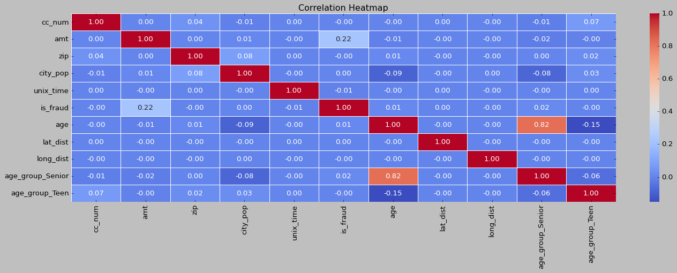
Credit Card Fraud Detection
Created Heatmap to understand the correlation between variables

Slide 11
05188142674597185
Credit Card Fraud Detection
Using Recursive Feature Elimination, R2 scores : 0.05188142674597185
Using Multiple Linear Regression, R2 scores : 0.05188142674597185
RandomForestRegressor(max_depth=4, max_features=None, min_samples_leaf=2, min_samples_split=4, n_estimators=200, random_state=42) Train Data = 0.275287309046242 Test Data = 0.269320694441645
Using Gradient Boosting Regressor: Train Data = 0.275287309046242,Test Data = 0.269320694441645
Model Evaluation: Hyperparameter Tuning: Train score: 0.3979203402107758 Test score: 0.31175924786072773

Slide 12
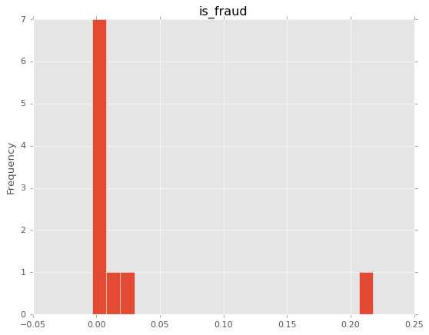
Credit Card Fraud Detection
We got to know that fraud depends upon amt (Amount of transactions).

